Slide 1
Topic modeling - BERTopic
Ali Hürriyetoğlu
SICSS-Istanbul
July 4, 2023

Slide 2
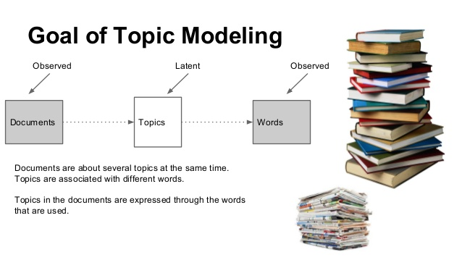
Topic modeling
Ref: https://theintelligenceofinformation.wordpress.com/2016/12/06/topic-modeling-latent-dirichlet-allocation-vs-correlation-explanation-alternative/

Slide 3
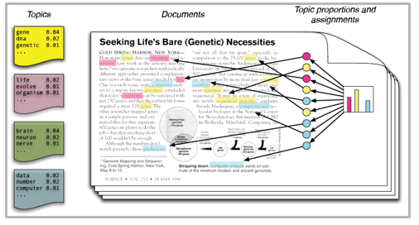
Topic modeling
Ref: https://www.analyticsvidhya.com/blog/2016/08/beginners-guide-to-topic-modeling-in-python/

Slide 4
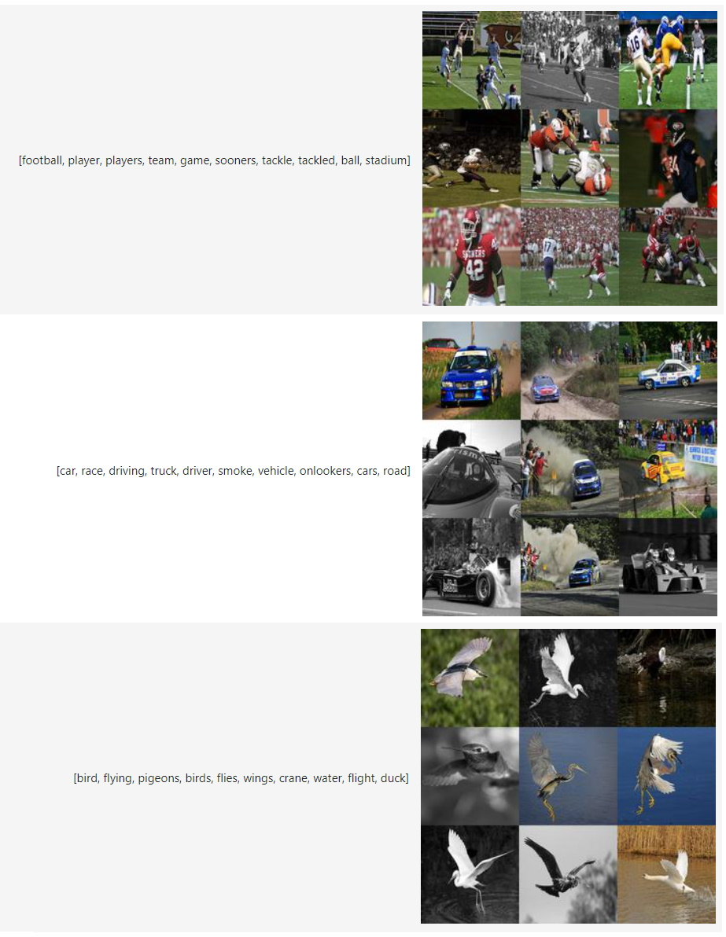
Multimodal topic modeling

Slide 5
Use cases
https://maartengr.github.io/BERTopic/usecases.html

Slide 6
Topic modeling - Exercises
Use the notebook on Colab as a basis for the following exercises:
Follow https://huggingface.co/blog/bertopic
to download a topic model and test it
to upload a model(s) you create to Huggingface. Ask a colleague/friend to download and try your model
Your first model can be the one create by running the code we run together.
Compare topics you create on the same dataset with a colleague/friend. Are they the same?
Use various sentence transformers & experiment with the multilingual models. Are the results different across different sentence transformers?
Find other datasets you can easily get in the environment and run the code on these datasets.
How would you evaluate quality of the topic modeling?

Slide 7
Tips
You can load data from
Huggingface: https://huggingface.co/docs/datasets/loading
Scikit-learn: https://scikit-learn.org/stable/datasets.html
You need to sign up and log in to Huggingface to upload your models
Signup on https://huggingface.co/join
Log in from your notebook and run the commands: i) from huggingface_hub import login ii) login()

Slide 8
More …
https://colab.research.google.com/github/kldarek/skok/blob/master/_notebooks/2021-05-27-Topic-Models-Introduction.ipynb

Slide 9
Thanks for listening!
What questions do you have?
Reach me at: ali.hurriyetoglu@gmail.com

